Slide 1
Women of the Big Book
Authors of personal stories

Slide 2
Florence Rankin—A Feminine Victory
New York, New York
Original Manuscript and page 217 in 1st Edition
First woman to get sober in AA
Date of Sobriety: March 1937

Slide 3
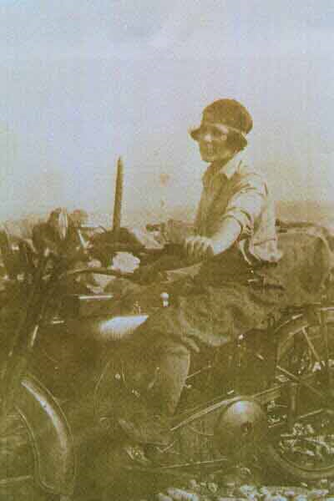
Lois Wilson
Lois Wilson rode a Harley

Slide 4
Bill and Lois Wilson
Co-Founder of Alcoholics Anonymous and his lady

Slide 5
Fitz Mayo—Our Southern Friend
Only story in all four Editions of Big Book
Started AA in Washington, DC

Slide 6
Marty Mann—Women Suffer Too
Founded National Council on Alcoholism

Slide 7
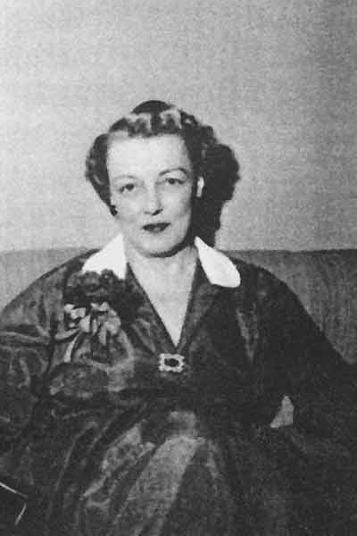
Sylvia Kauffman—The Keys of the Kingdom
Chicago, Illinois
Page 304 in 2nd and 3rd Editions and 268 in the 4th
Date of Sobriety: September 13, 1939
Helped start AA in Chicago

Slide 8
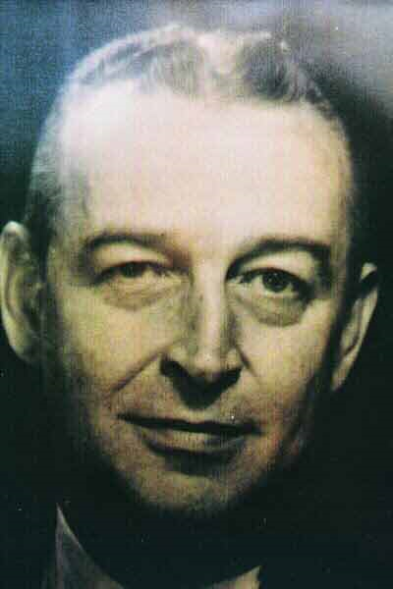
Earl Treat—He Sold Himself Short
Helped start AA in Chicago
Assisted Bill Wilson with Traditions

Slide 9
Bill Wilson
Bedford Hills, New York
Co-Founder of Alcoholics Anonymous

Slide 10
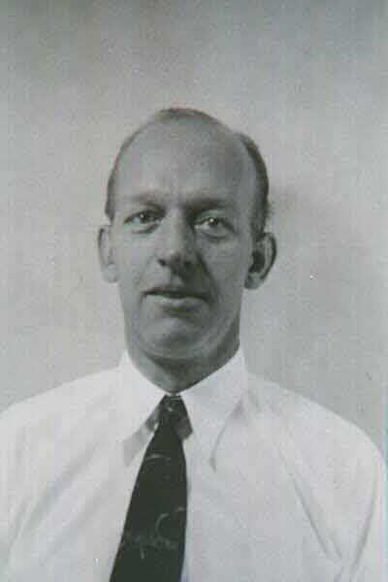
Clarence Snyder—Home Brewmeister
Started AA in Cleveland, Ohio

Slide 11
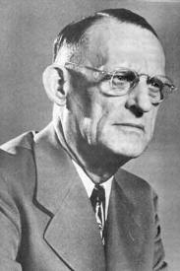
Dr. Robert Holbrook Smith (Dr. Bob)
Akron, Ohio
Co-Founder of Alcoholics Anonymous

Slide 12
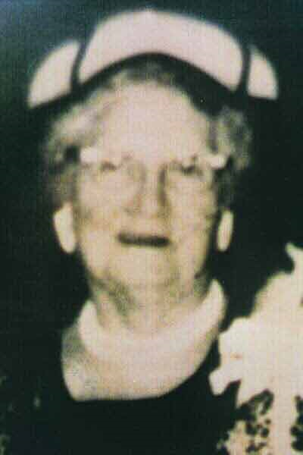
Ethel Macy, From Farm to City
Akron, Ohio
Page 261 in 2nd and 3rd Editions
Date of Sobriety: May 8, 1941

Slide 13
Dr. Bob and Anne Smith
Akron, Ohio

Slide 14
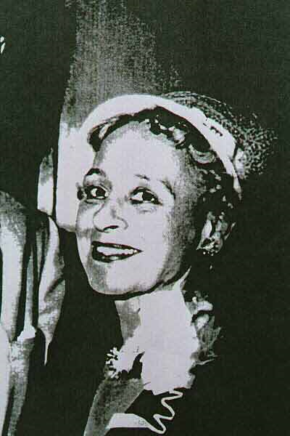
Esther Elizardi—A Flower of the South
Houston, Texas
Page 343 in 2nd Edition, Page 384 in 3rd Edition
Date of Sobriety: May 16, 1941

Slide 15
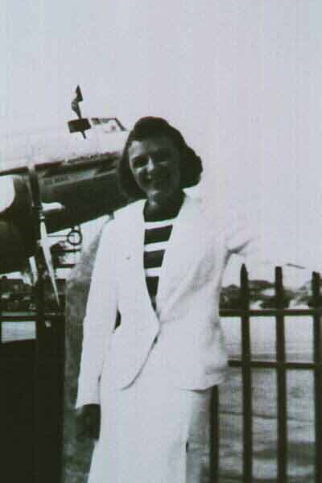
Ruth Hock
“Ruth Hock, our nonalcoholic secretary, typed away as I slowly dictated the chapters of the text for the new book.” Bill W.

Slide 16
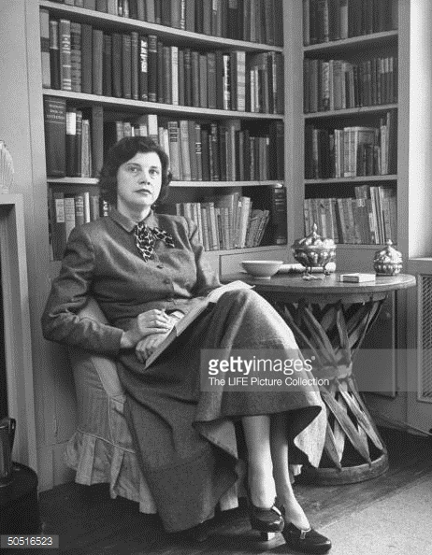
Countess Felicia Gizycka—Stars Don’t Fall
New York City, New York
Page 401 in 2nd Edition, Page 400 in 3rd Edition
Date of Sobriety: 1944

Slide 17
Drew Pearson
Newspaper Reporter
One of the best-known American columnist of his day

Slide 18
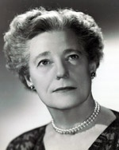
Dr Ruth Fox
First medical director of The National Council on Alcoholism

Slide 19
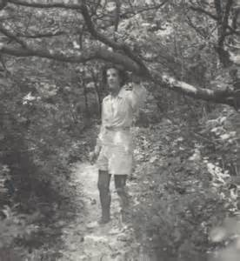
Priscilla Peck
Long-time member of AA
and long-time lover of Mrs. Marty Mann

Slide 20
Vogue Magazine
Priscilla Peck, Art Director

Slide 21
1967 Grapevine
Contains update of Countess Felicia Gizycka’s story

Slide 22
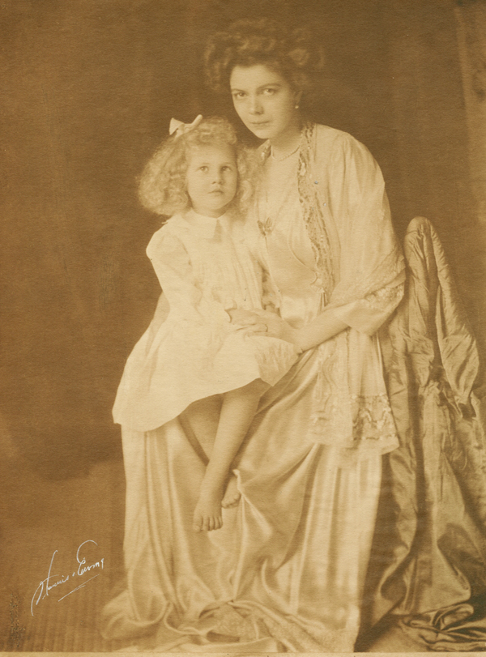
Countess Felicia Gizycka
With mother, Eleanor Medill “Cissy” Patterson, editor of the Washington Times.

Slide 23
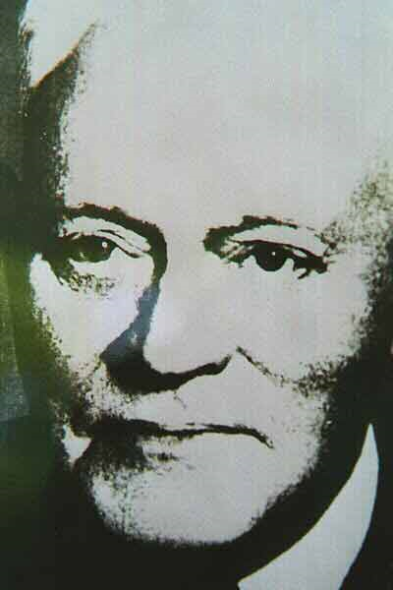
Dr. William Duncan Silkworth
The Doctor’s Opinion
The little doctor who loved drunks

Slide 24
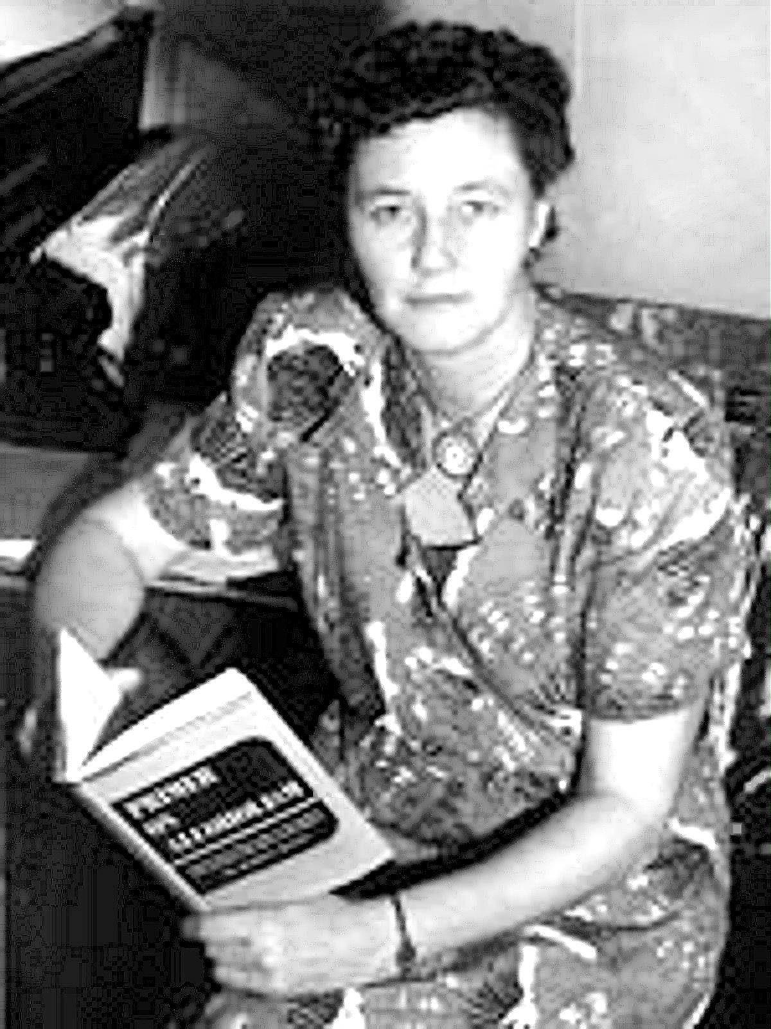
Marty Mann
Founder of the National Council of Alcoholism

Slide 25
Wynn Laws—Freedom from Bondage
Ventura, California
Page 553 in 2nd Edition and Page 544 in 3rd and 4th Editions
Date of Sobriety: 1947

Slide 26
Wynn Corum Laws
Author of Freedom from Bondage

Slide 27
Wynn and George Laws
George was Carolyn See’s father
Wynn and George were both sober alcoholics

Slide 28
Carolyn See
Author and step-daughter of Wynn Corum Laws

